Slide 1

Financial Analytics Report
MOHD RAHIL

Slide 2
Introduction
Understanding the competitive landscape is crucial for any business aiming to thrive in its industry. In today's dynamic market environment, analyzing competitors provides valuable insights into market trends, consumer preferences, and potential threats and opportunities. In this analysis, we delve into the market capitalization data of the top 500 companies in India, aiming to extract key metrics and unveil meaningful relationships between attributes. By doing so, we aim to empower the management with actionable insights to enhance decision-making and drive sustainable growth. Through thorough research and analysis, we present findings that illuminate the competitive dynamics shaping the Indian business landscape.

Slide 3
Project Details
Project Title | Financial Analytics
Technologies | Data Science
Domain | Finance
Tools | POWER BI

Slide 4
Problem Statement
Without analyzing the competition, it is difficult for a business to survive. You are tasked to analyse the competition for the management to provide better results. This data set has information on the market capitalization of the top 500 companies in India. Serial NumberNameName of CompanyMar Cap – CroreMarket Capitalization in CroresSales Qtr – CroreQuarterly Sale in crores. Find key metrics and factors and show the meaningful relationships between attributes. Do your own research and come up with your findings

Slide 5
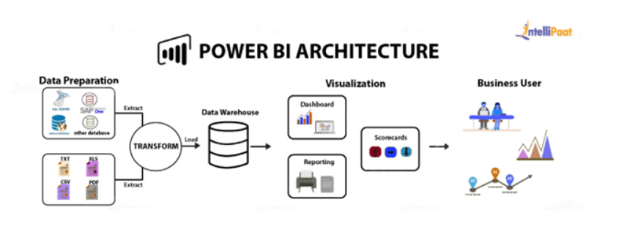
Architecture

Slide 6
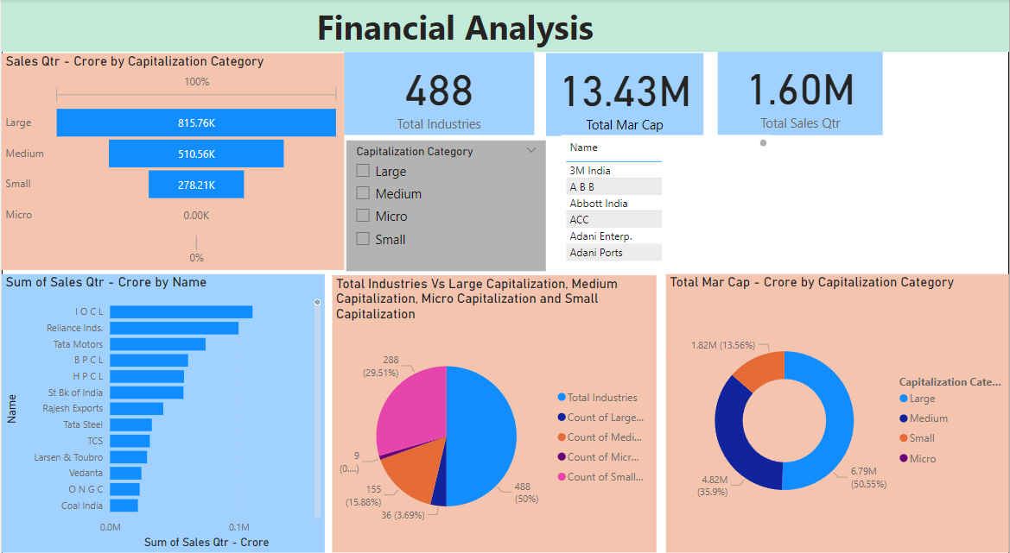
MY Dashboard
Overview Analysis

Slide 7
Thank YOu
MOHD RAHIL

